Slide 1
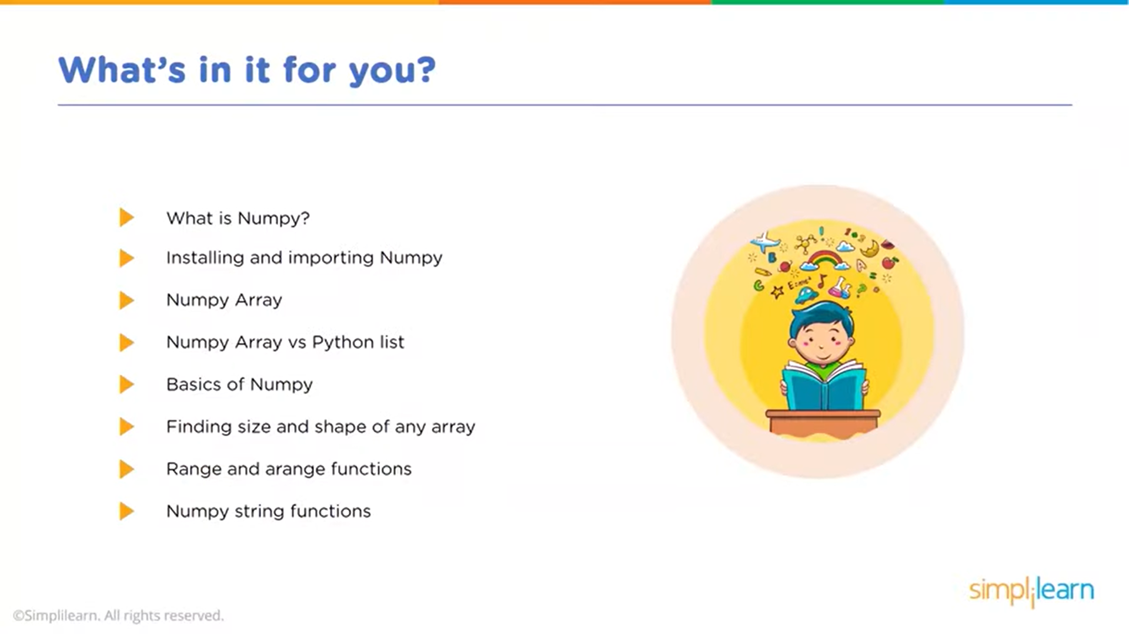

Slide 2
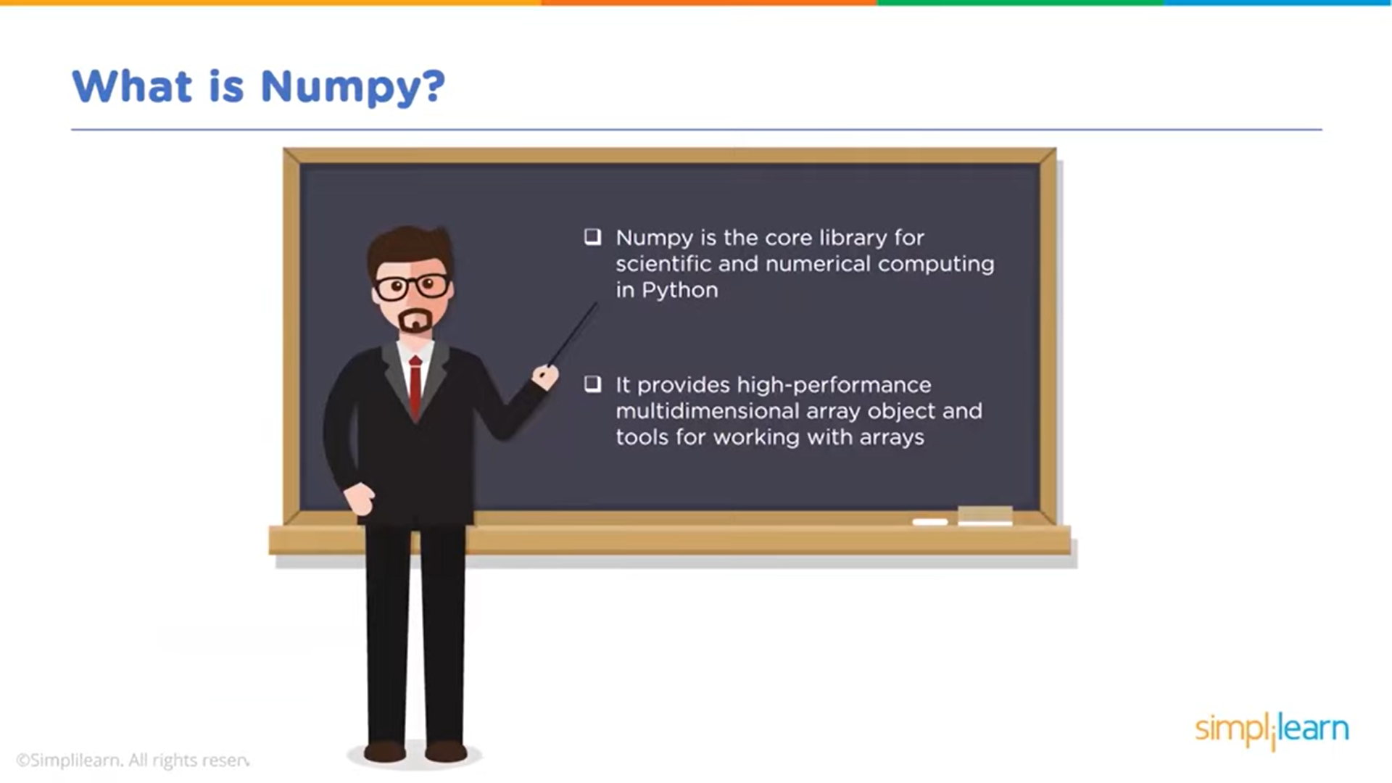

Slide 3
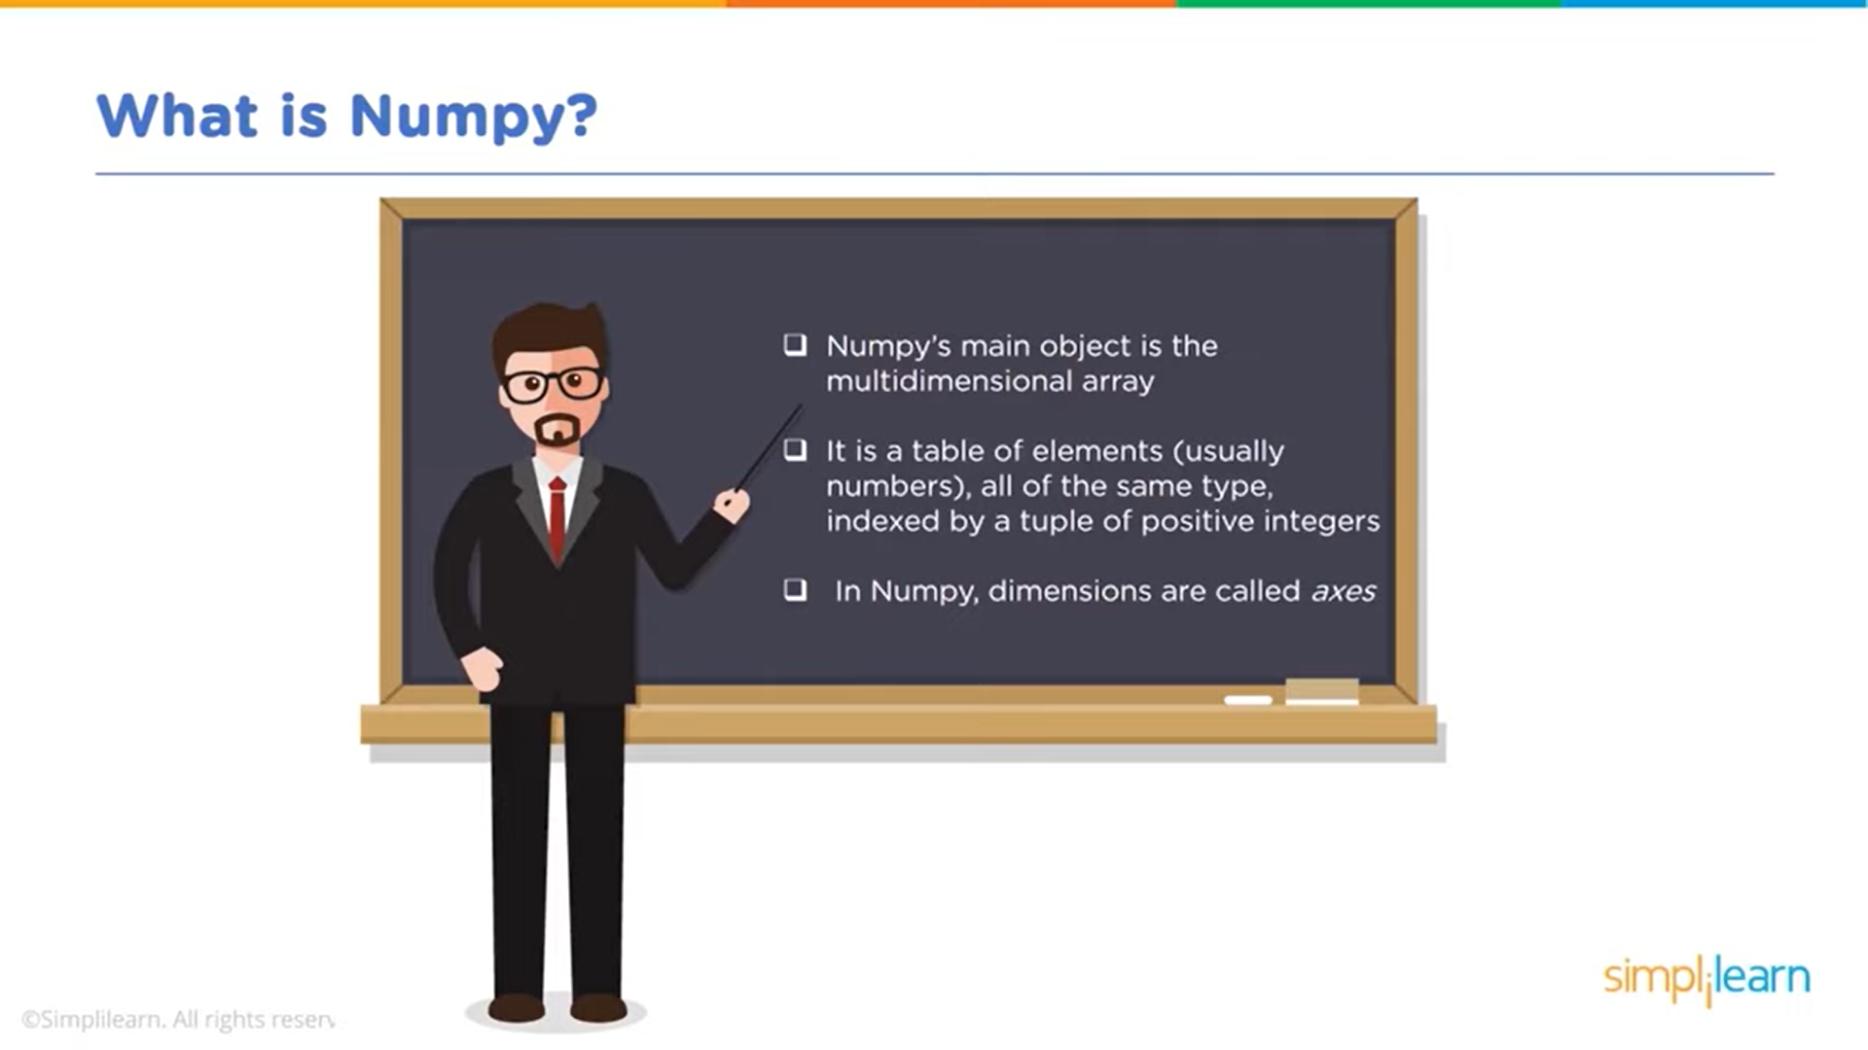

Slide 4
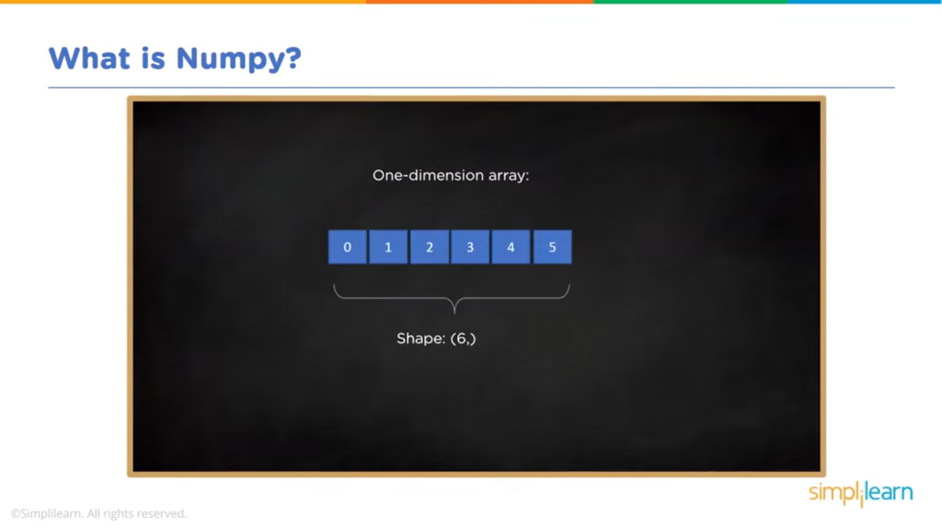

Slide 5
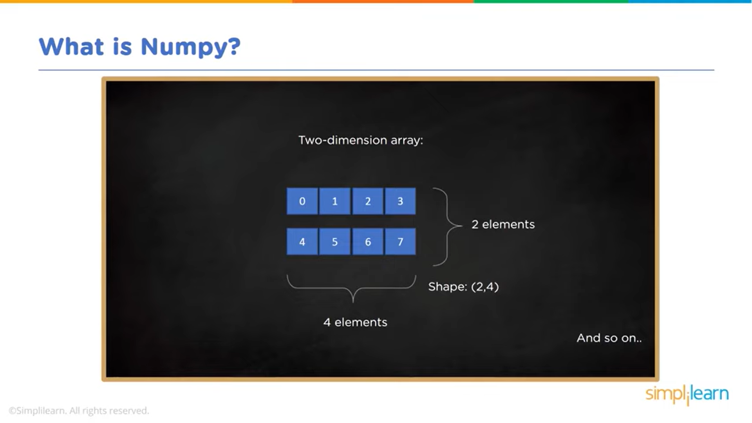

Slide 6
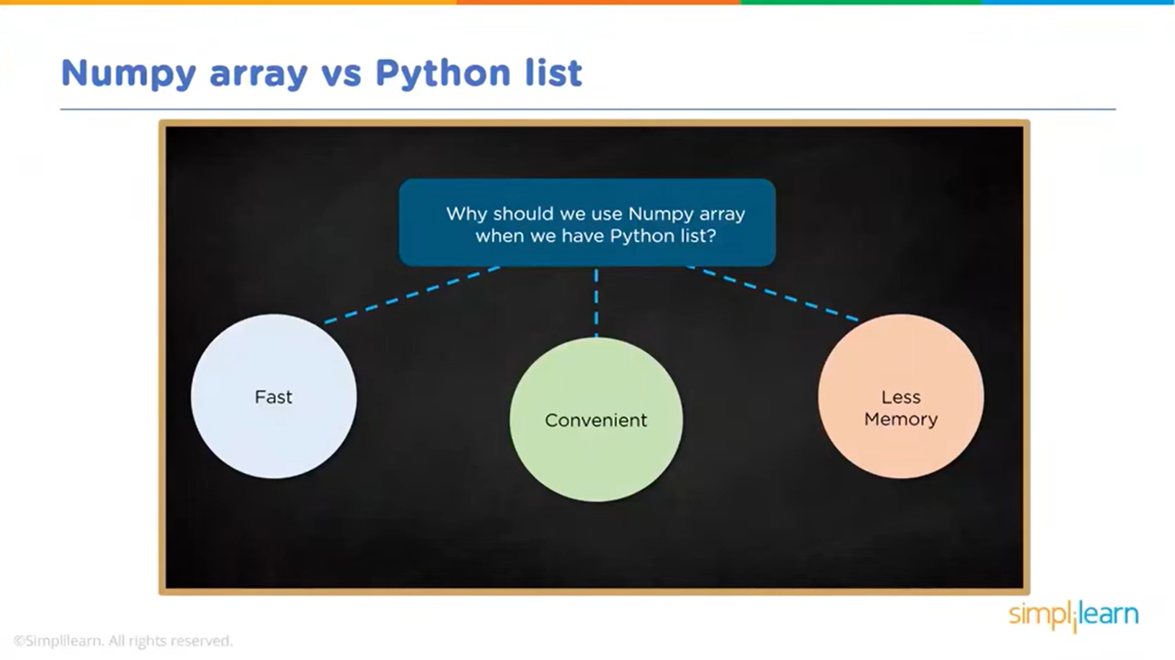

Slide 7

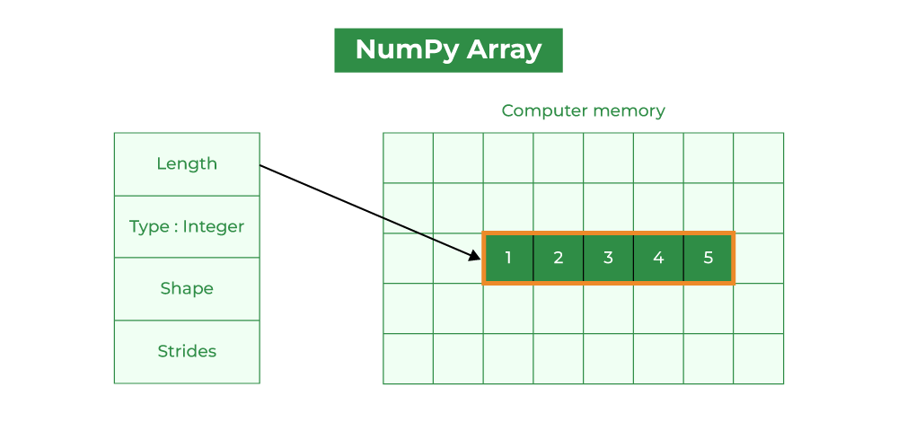
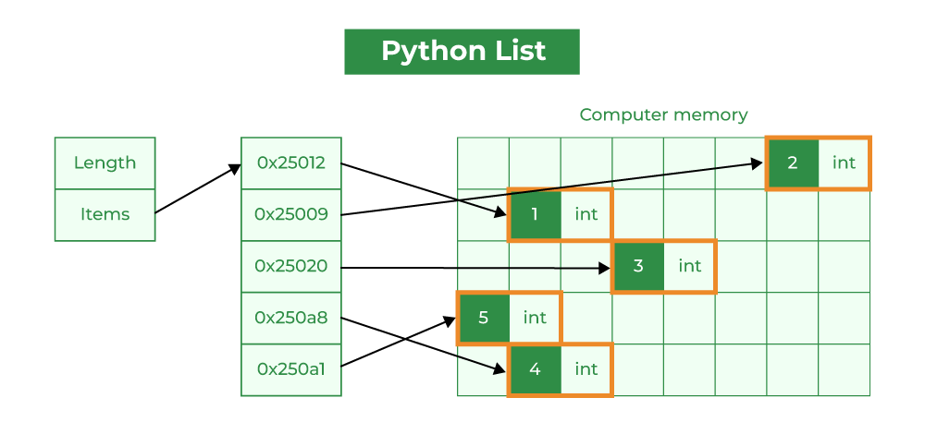

Slide 8

numpy\01-NumPy Arrays.ipynb numpy\02-Numpy Indexing and Selection.ipynb numpy\03-Numpy Operations.ipynb numpy\05-Numpy Exercises - Solutions.ipynb

